Slide 1

Capstone Project Presentation
Foundations of Data Science Course
Student: Reza Nickmanesh
Mentor: Tom Hopper
June 2017

Slide 2
Overview
Project Description
Domain Knowledge
Data Set
Exploratory Analysis
Model Building
Results and Discussion

Slide 3
Project Description
Project objective: Development of predictive models for diagnosis of breast cancer stage (benign vs. malignant cases) based on digitized images of breast mass.
Metrics model evaluation: accuracy, sensitivity, specificity, and misclassification error.

Slide 4
Domain Knowledge
Breast cancer is the second most prevalent cancer and second leading cause of cancer death among US women
Fine needle aspiration (FNA) is the gold standard method for diagnosis of breast cancer stage
FNA procedure involves sampling the fluid of the lump and examining it by microscope
Features observed in the microscope image (e.g. cell area, radius, texture) are different between benign and malignant cases. These features are used for diagnosis in clinical practice.

Slide 5
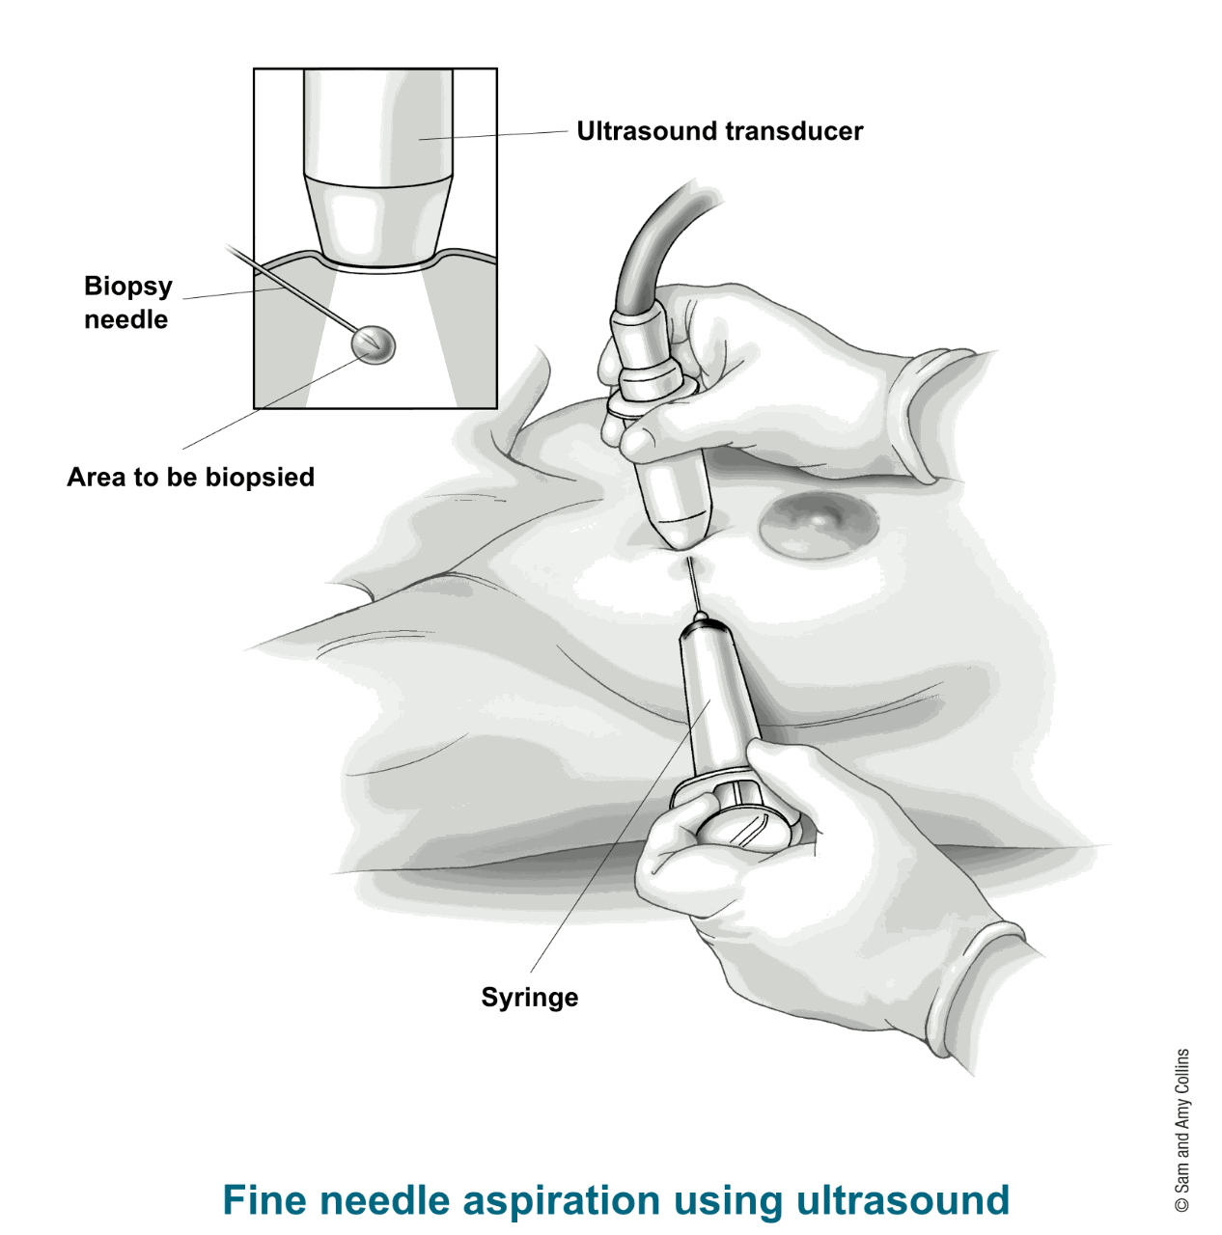

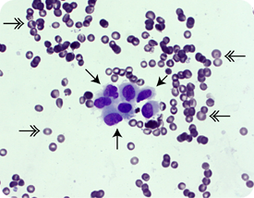
Domain Knowledge
Physician’s visual assessment of these images lacks the accuracy and repeatability required for cancer diagnosis.
Automatic extraction of these features combined with development of advanced machine learning algorithms could be the best option for more accurate and reliable diagnosis of breast cancer.

Slide 6
Domain Knowledge
Benchmark model: Previous papers investigated different imaging modalities in combination with machine learning algorithms for breast cancer diagnosis. The accuracy of those methods was studied to determined the benchmark model in our project.
The model with the highest level of accuracy in our literature review (93.6%) was selected as our benchmark model to ensure that our final model outperforms the existing models.
Paper | Image modality | Accuracy
(Zhang, Wang, Liu, & Yang, 2016) | Mammography | 92.16
(Zhang et al., 2016) | Mammography | 91.37
(Tozaki & Fukuma, 2011) | Mammography | 90.7
(Görgel, Sertbas, & Uçan, 2015) | Mammography | 90.1
(Chung et al., 2013) | MRI | 93.6
(Chung et al., 2013) | Ultrasound | 79.1

Slide 7
Data Set
Data set includes 569 observations of 30 independent variables and one dependent variable (outcome measure)
There are no missing values in the data set
30 independent variables included mean, standard error, and worst (or the largest) values of 10 characteristics of the cell nuclei.
The independent variable (outcome measure) represents the stage of the cancer (benign or malignant)
Radius | Perimeter
Concavity | Concave.points
Area | Texture
Fractal_dimension | symmetry
Compactness | Smoothness
Diagnosis= B- benign or M-malignant

Slide 8
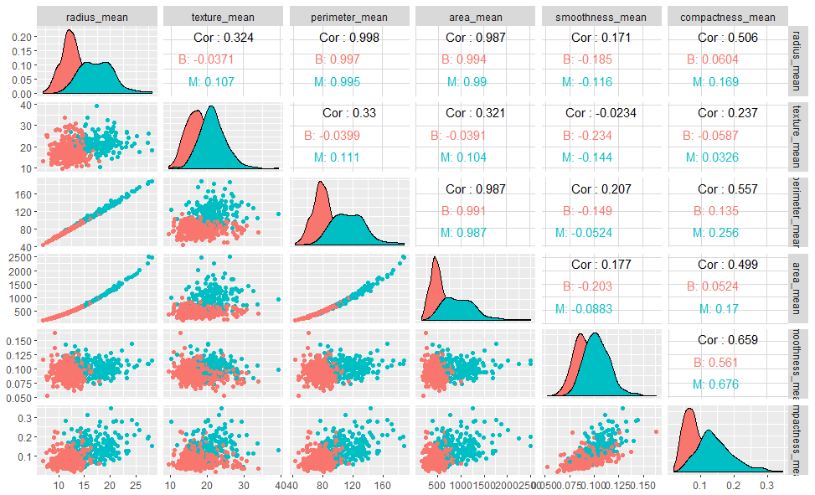
Exploratory Analysis
Distribution of variables in each outcome classes (red represents benign and green represents malignant cases) and correlation among variables (highly correlated variables exist in this data set).

Slide 9
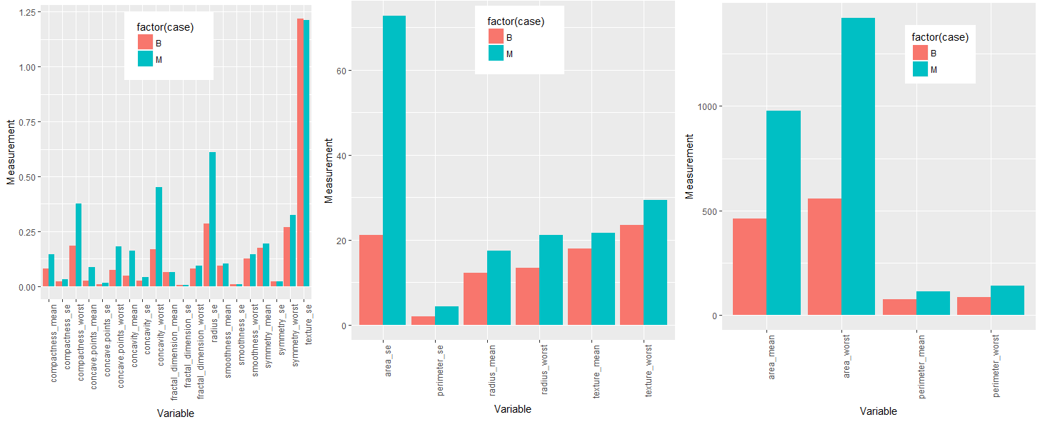
Exploratory Analysis
Comparison of mean values of the variable between benign and malignant cases.
In general, malignant cases have higher values (green vs. red bar plot).

Slide 10
Model Building
The predictive power of various algorithms and techniques is evaluated for breast cancer data set:
  Logistic regression model
  K-means clustering
  K-nearest neighbor
  Tree-based algorithms
    Classification and regression tree
    Bootstrap aggregating (bagging)
    Adaptive boosting
    Random forest

Slide 11
Model Building (Logistic Regression)
There are highly correlated variables in this data set and therefore it was needed to find the best subset regression to avoid collinearity in the model.
5 logistic regression models were developed:
  Logistic regression model with all 30 variables
  Logistic regression model with the selection of the best predictors (best subset regression model selection algorithm was used for this purpose).
  Logistic regression model with principal component version of the variables.
  Logistic regression model with the first 10 principal components of the data which explains more than 95% of the variance.
  Logistic regression model with the first 20 principal components of the data which explains more than 99% of the variance.

Slide 12
Model Building (Logistic Regression)
Summary of the logistic regression model:
The logistic models with the best subset of variables and with the first 20 principal components outperformed the other models.
Logistic Regression Model/Measure | Accuracy | Sensitivity | Specificity | Misclassification Error (%) | AUC
Diagnosis ~ all variables | 0.95 | 0.93 | 0.97 | 4.4% | 0.94
Diagnosis ~ best subset of variables | 0.97 | 0.95 | 0.98 | 2.65% | 0.98
Diagnosis ~ all principal components | 0.95 | 0.95 | 0.95 | 5.3% | 0.95
Diagnosis ~ first 10 principal components | 0.95 | 0.95 | 0.95 | 5.3% | 0.99
Diagnosis ~ first 20 principal components | 0.96 | 0.95 | 0.97 | 3.5% | 0.99

Slide 13
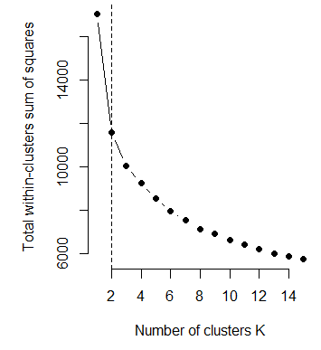
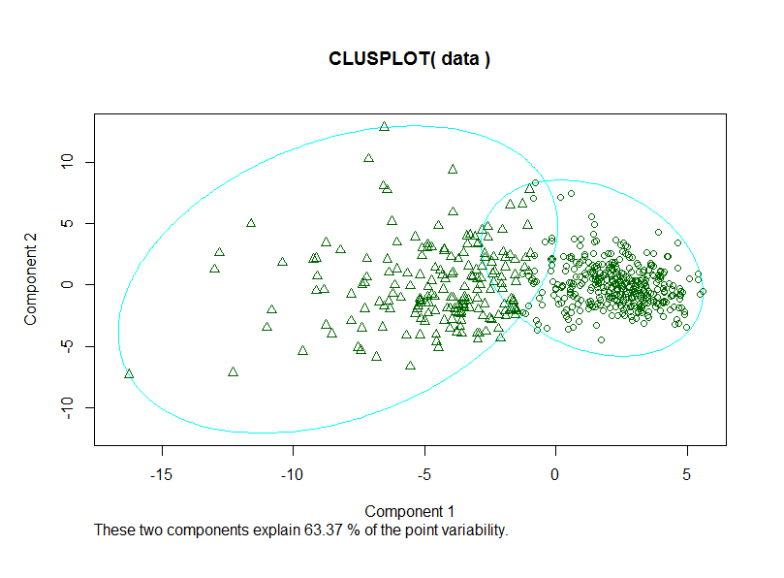
Model Building (K-means Clustering)
K-means clustering is an unsupervised learning algorithm.
The number of clusters was predetermined in our data set. However, the plot of total within groups sums of squares was generated to confirm the assumption of 2 clusters.
Accuracy | 0.91
Sensitivity | 0.82
Specificity | 0.96
Misclassification Error (%) | 8.9%

Slide 14
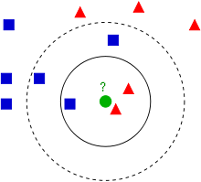
Model Building (K-nearest neighbor)
K-nearest neighbor algorithm uses majority votes among the classification of k objects. Determining the optimal value for k is the essential first step.
10-fold cross validation algorithm suggested k=9 as the optimal value of k which was used in our final analysis (the result is shown below).
Accuracy | 0.96
Sensitivity | 0.90
Specificity | 0.99
Misclassification Error (%) | 4.4%
K=9

Slide 15
Model Building (Tree-based algorithms)
Decision tree method is not a strong machine learner. Therefore, this method was combined with other methods (bagging, boosting, and random forest) to improve the performance.
10-fold cross validation algorithm was used to determine the optimal parameters for each of the techniques. Tables below summarized the results:
Model/Measure | Cross-Validation Accuracy | Accuracy | Sensitivity | Specificity | Misclassification Error (%)
Decision tree | 0.91 | 0.92 | 0.88 | 0.94 | 7.9%
Bagging | 0.95 | 0.95 | 0.95 | 0.94 | 5.3%
Adaptive boosting | 0.96 | 0.98 | 0.95 | 1 | 1.8%
Random Forest | 0.95 | 0.98 | 0.95 | 1 | 1.8%

Slide 16
Results and Discussion
Model evaluation:
Random forest and adaptive boosting had the best performance.
Other than decision tree and k-means algorithm, all models outperformed our benchmark model (accuracy=93.6%)
Model/Measure | Accuracy | Sensitivity | Specificity | Misclassification Error (%)
Best logistic model | 0.97 | 0.95 | 0.98 | 2.7%
Best logistic model with principal components | 0.96 | 0.95 | 0.97 | 3.5%
Kmeans | 0.91 | 0.82 | 0.96 | 8.9%
Knn | 0.96 | 0.90 | 0.99 | 4.4%
Decision Tree | 0.92 | 0.88 | 0.94 | 7.9%
Bagging | 0.95 | 0.95 | 0.94 | 5.3%
Adaptive Boosting | 0.98 | 0.95 | 1 | 1.8%
Random Forest | 0.98 | 0.95 | 1 | 1.8%

Slide 17
Results and Discussion
Decision tree method had the second lowest accuracy (92%) after k-means model. However, implementing other machine learning methods (bagging, boosting, and random forest) combined with decision tree learning significantly improved the accuracy of the model (92% vs. 95%, 98%, and 98%).
Random forest could be considered as the model of choice in our data set. This model has equal performance compared to adaptive boosting, however, the processing time was faster than adaptive boosting.

Slide 18
Future Work
This data lacks the information about the progression of breast cancer in benign and malignant cases. Therefore, some questions such as “when/what percentage of benign cases develop breast cancer in future?” or “when is the best time for intervention in malignant cases?” could not be answered with this data set. Including those information in the data set could potentially lead to development of more accurate and reliable methods for diagnosis.
It would worthwhile to use ensemble learning methods used in this study and combine it with other potential methods (e.g. SVM, neural network, and so forth) to see if using a voting model based on all of the methods could improve the accuracy of our current model.

